Slide 1
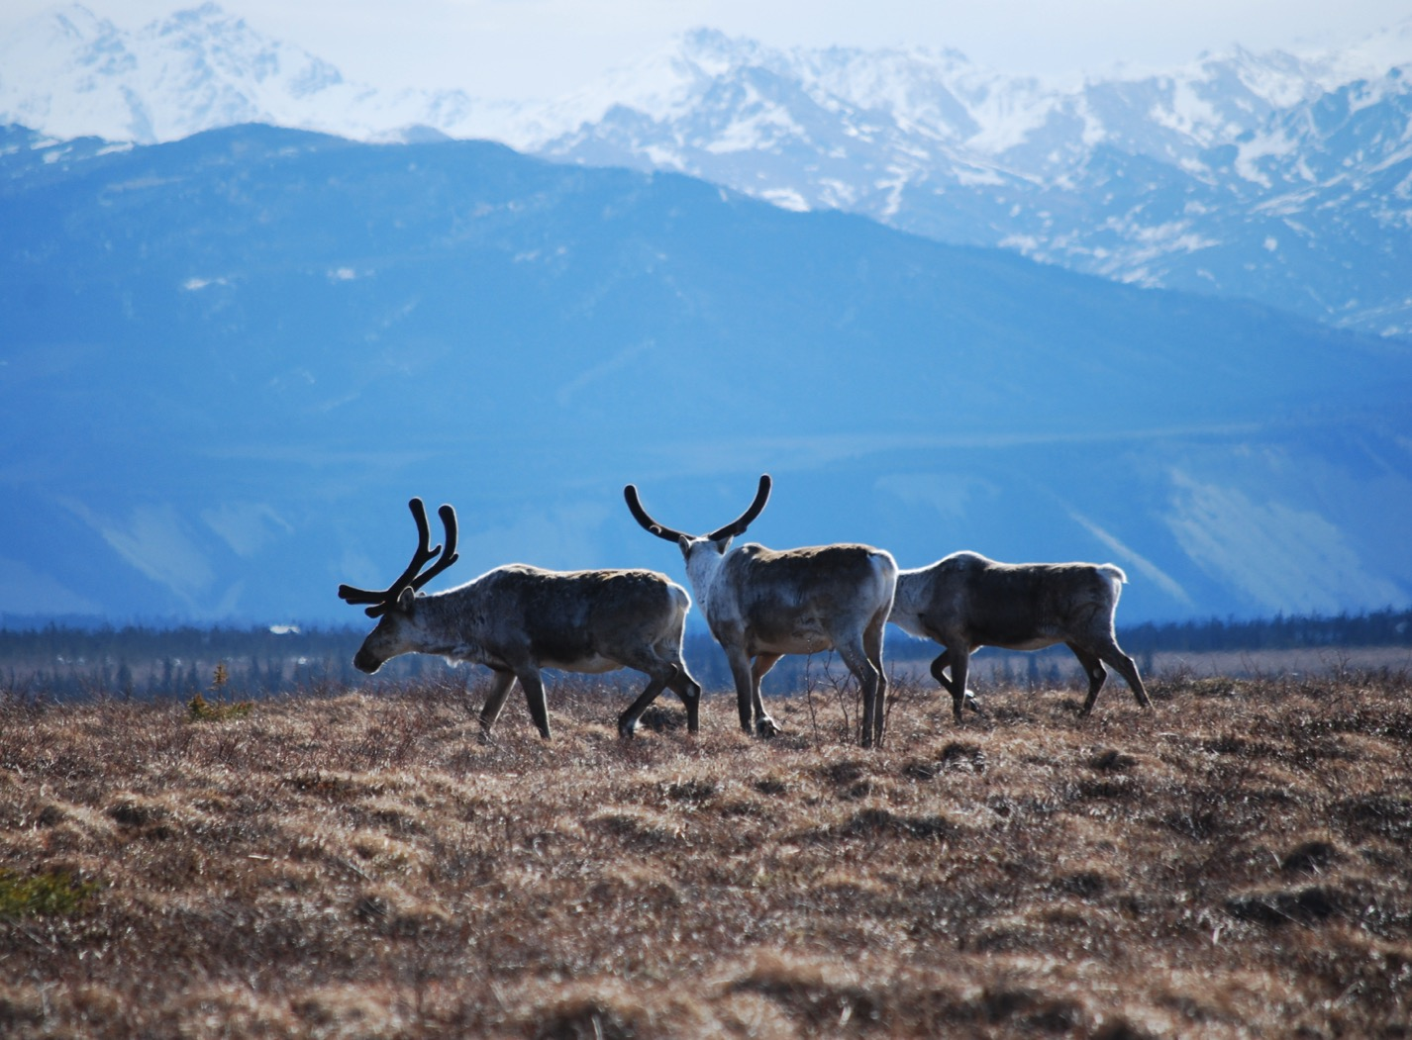
Arctic Boreal Vulnerability Experiment (ABoVE)
2017 ABoVE Airborne Campaign
20 June 2017 (DOY 171)
UAVSAR: Mackenzie Valley
Charles Miller, Deputy Science Lead
Jet Propulsion Laboratory, California Institute of Technology
and the ABoVE Science Team For Hank Margolis, Eric Kasichke, Bruce Tagg
NASA HQ
2017

Slide 2
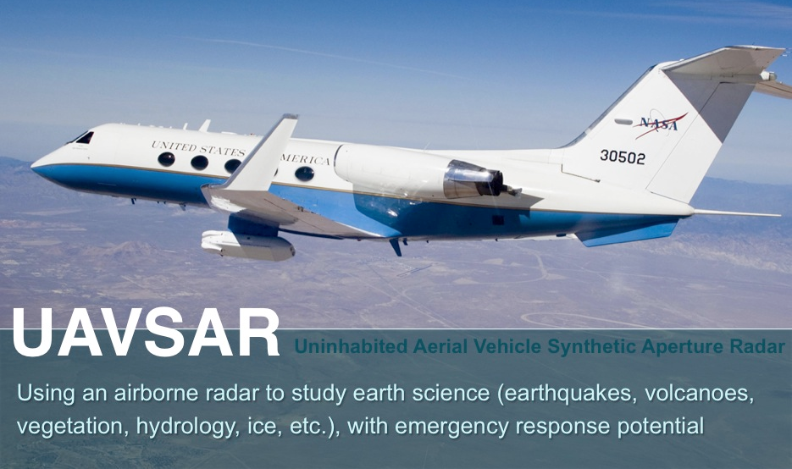
20 June 2017/DOY 171 Mackenzie Valley
Daily Summary:
C-20A (N30502) UAVSAR ABoVE CAMPAIGN (CANADA / ALASKA)
REPORT DATE: 20 June 2017
Current Status of Aircraft: GREEN
Current Status of SAR: YELLOW
Current Status of PPA: GREEN
Current Deployment Location: Fairbanks, Alaska (PAFA)
Crew: Asher, Barry, Griffith, Choi, T Miller
Science Coordinator: N Pinto
Science Lead: M Moghaddam
Project Manager: Y Lou

Slide 3
20 June 2017/DOY 171 Mackenzie Valley
Daily Summary:
Science Flight (PAFA – PAFA #4) – 5.6 hours
Ok flight
Collected 5 of 7 data lines
Missed Lines: #3 & #4
Aklavik, Norman Wells, Inuvik, Tuk, Old Crow
Flight Plan – 1132v03
Problem with fuel expansion and leak this morning, delayed takeoff
Larger Red Flag area than expected – required longer detour
Radar started rough, failed on every line until line #5 but worked well after that; no data for Lines 3 & 4 (flatline); enough of line 1 was acquired; Line 2 had “wandering” problems where NAV file didn’t match radar line; navigated manually until engaged PPA, started radar manually, but there was a jump upon PPA engagement

Slide 4
20 June 2017/DOY 171 72-Hour Look Ahead
All plans weather dependent
Wednesday 21 June 2017 (DOY 172):
North Slope
Thursday 22 June 2017 (DOY 173):
Contingency Day
Friday 23 June 2017 (DOY 174):
Transit to Palmdale

Slide 5
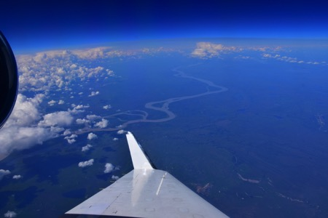
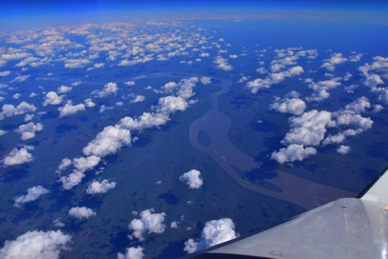
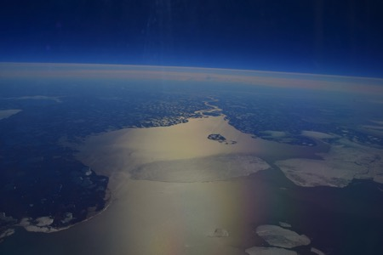
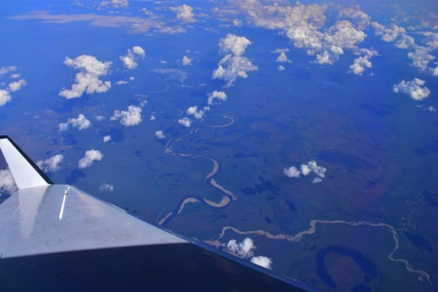
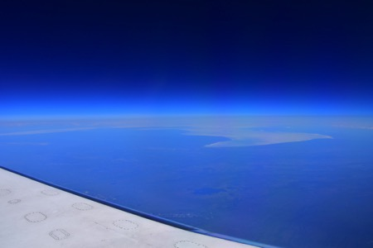
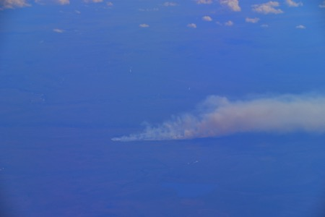
20 June 2017/DOY 171 Mackenzie Valley
Stevens Village
Tuktoyaktuk
Beaver
Tundra fire
The lakes and wetlands of the Old Crow Flats, including a tundra fire along with the bay at Tultoyaktuk

Slide 6
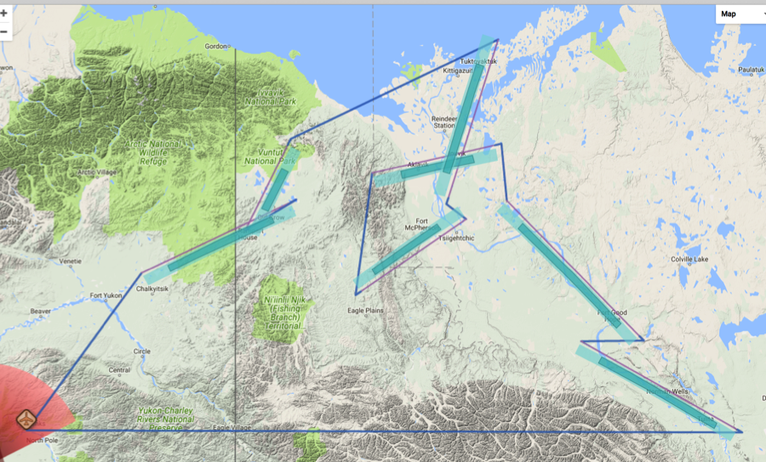
20 June 2017/DOY 171 Mackenzie Valley
Flight Plan 1132 v02, Report 17068: Fairbanks AK (PAFA) – PAFA
https://uavsar.jpl.nasa.gov/cgi-bin/report.pl?planID=PLAN_17068#map
Data Acquisitions:
Line 1, ID 29904: Norman Wells
Line 2, ID 32200: Ft Good Hope
Line 3, ID 25702: Aklavik
Line 4, ID 05529: Ft McPherson
Line 5, ID 01703: Tuk Hwy
Line 6, ID 20705: Old Crow 1
Line 7, ID 24401: Old Crow 2
Way points fixed to P-band plan
1115
P-band keep-out zone shown in RED
(centered on Clear, AK: 64.29 N, 149.19 W)
01703
25702
20705
24401
05529
32200
29904
Flight plan & acquisition segments

Slide 7
20 June 2017/DOY 171 Mackenzie Valley
UAVSAR Quick-look products
A. Line 1, ID 29904_000: Norman Wells
B. Line 2, ID 32200_104: Ft Good Hope
C. Line 3, ID 25701: Aklavik (failed)
Joanne Shimada, JPL
A
B
A. Radar flat lined prior to the end of the line; Scientist on Board declared sufficient data acquired for this line
B. Fort Good Hope line samples extensively along the lower Mackenzie River with adjacent lakes and wetlands; radar failed priori to line completion – reacquisition recommended

Slide 8
20 June 2017/DOY 171 Mackenzie Valley
UAVSAR Quick-look products
Line 5, ID 01713_018: Tuk Hwy (failed)
Line 5, ID 01713_019: Tuk Hwy (refly)
Joanne Shimada, JPL
A
B
A. Radar flat lined shortly after the flight line crossed the taiga – tundra transition
B. 2nd pass successful. Noticeable digital noise in the quick-look product over the tundra
Not Shown: Line 4, ID 05529: Ft McPherson (failed)
Notes:
Note this swath captures an intensive RadarSat-2 targeted swath along the Inuvik – Tuktoyaktuk Highway

Slide 9
20 June 2017/DOY 171 Mackenzie Valley
UAVSAR Quick-look products
A. Line 6, ID 20705_020: Old Crow 1
B. Line 7, ID 24400_021: Old Crow 2
Joanne Shimada, JPL
A
B
A. Dense wetlands of the Old Crow Flats seen on the left side of the panel. This region is a transition between tundra wetlands of the Arctic Coastal Plain and the boreal wetlands of the Yukon Flats and Mackenzie Valley
B. A ~200 km long swath along the Porcupine River from Old Crow YT into Alaska

